Slide 1



Food and farming
Student meeting in Belgium
19-24 February 2017

Slide 2
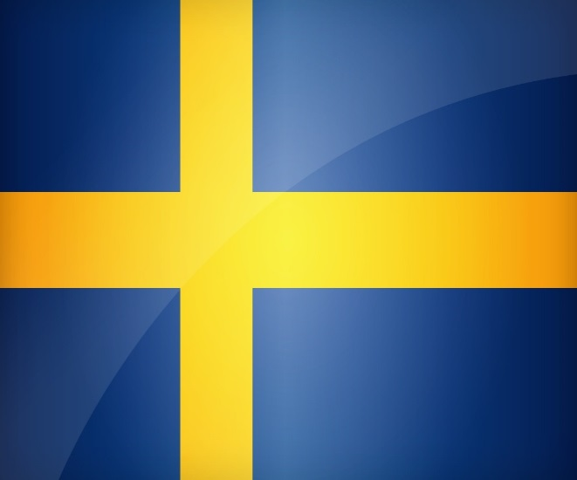

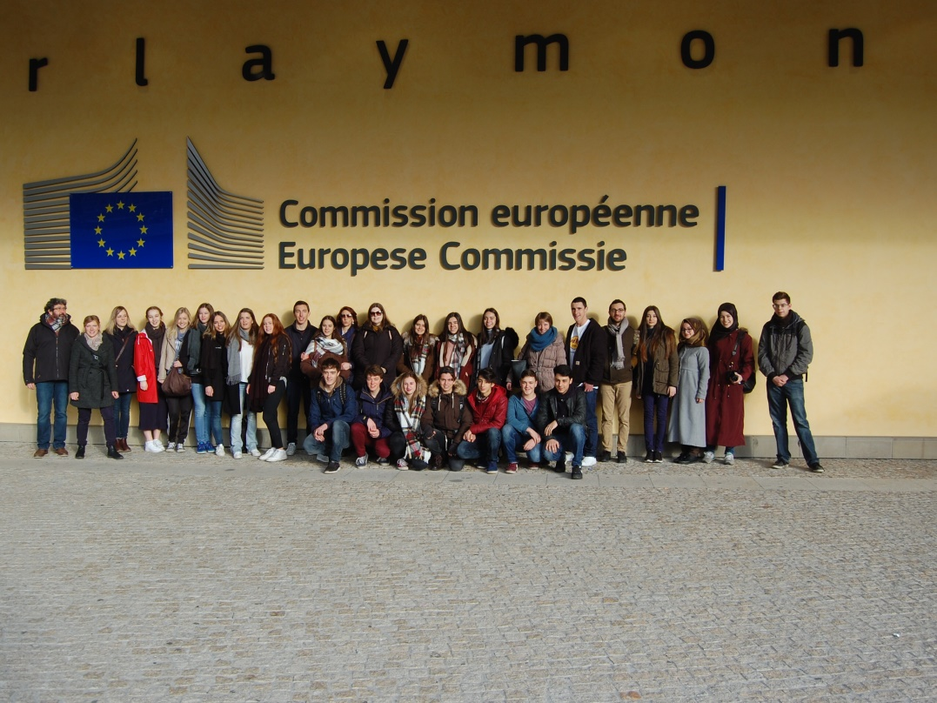



Food and farming
Portugal, Sweden, Turkey, Belgium

Slide 3
1. What is COP21? What were the main goals that were set in Paris?
In 2015 the COP21, also known as the 2015 Paris Climate Conference, was a U.N. climate change conference where the countries in the world got together to agree upon a new global climate agreement that will apply from 2020.
The main goals are:
To keep global temperatures "well below" 2.0C (3.6F) above pre-industrial times and "endeavour to limit" them even more, to 1.5C;
To limit the amount of greenhouse gases emitted by human activity to the same levels that trees, soil and oceans can absorb naturally, beginning at some point between 2050 and 2100;
To review each country's contribution to cutting emissions every five years so they scale up to the challenge;
For rich countries to help poorer nations by providing "climate finance" to adapt to climate change and switch to renewable energy.

Slide 4
2. What is an Ecological Footprint?
Describe it with an example. Give the average Ecological Footprint of an adult in your country and on each continent.
The Ecological Footprint measures how fast we consume resources and generate waste compared to how fast nature can absorb our waste and generate new resources.
For example : to produce 1 kilo of meat, it is necessary to have:
10 m² of the pasture for the cattle,
11 m² of cultivated surfaces (to produce the food of the cattle),
2,4 m² of built surfaces (for cowsheds, etc.)
21 m² to absorb the CO₂ emitted for the transport of the meat, etc.)
That means : 44.4 m² for 1 kilo of meat
The average Ecological Footprint (in global hectares / person)
Belgium: 7,4 Asia: 3,5 to 5,25
Portugal: 3,5 Africa: 1,75
Sweden: 5,88 America: 7
Turkey: 1,24 Europe: 3,5 to 7
Oceania: 7

Slide 5
3. Do countries have laws or rules like taxes to reduce the Ecological Footprint?
Some countries have laws that aim at reducing man’s impact on the environment, such as:
Lower taxes on electrical cars;
Financial benefits for people using solar panels;
Taxes on gasoline (whereas there are no taxes on biogases);
Bonuses are given to isolate buildings;
Taxes on water treatment;
Taxes on electricity;
Taxes on nuclear power;
Taxes on waste;
Taxes for the recycling of domestic appliances;
In Sweden you can ‘panta’ a bottle or can, which means that you pay a little bit extra for a soda and in return get the same amount of money when ‘giving the bottle back’.

Slide 6
4. Which initiatives can help reduce the Ecological Footprint in the farming industry?
Making national productions bigger, so imports can be reduced;
Reducing transport distances nationally;
Making the farming industry more effective, by using new technologies;
Promoting organic farming, using modern and ecofriendly technologies;
Decreasing food waste;
Using biomethanisation, a natural process of decomposition of farm waste by microorganisms in the absence of oxygen, in darkness and under specific temperature and pH conditions. The biogas thus produced is rich in methane and can therefore, be burnt to produce electricity and heat. We also obtain a digestate which can serve as amendment for the crops.

Slide 7
5. To reduce CO₂, what are ways to stock it?
Reforestation: planting a lot of trees that can take care of some CO_{2;}
Wood: when a tree grows, it absorbs carbon. That carbon is then released if the wood is burnt, or as it rots away naturally. So if we make things out of wood, the carbon is safely preserved. An oak dining table is a form of long term carbon storage. Provided it is sustainably harvested, we could work towards negative emissions by using more wood as a building material or for quality furniture;
Storing CO₂ in geological formations;
Mixing CO2 in water pumped in the ground to reinject the solution in the volcanic basalt. A chemical reaction occurs and the carbon is transformed into a chalky mineral.

Slide 8
6. What is the Ecological Footprint for the production of one kilogramme of beef, pork, lamb and chicken meat, salmon, one litre of milk, compared to wheat?
Beef: 27,0 kg carbon dioxide
Pork: 12,1 kg carbon dioxide
Lamb: 39,2 kg carbon dioxide
Chicken: 6,9 kg carbon dioxide
Salmon: 11,9 kg carbon dioxide
Milk: 1,9 kg carbon dioxide
Wheat: 2,7 kg carbon dioxide

Slide 9
7. What are, for each season, examples of fruit and vegetables?
In Belgium:
Winter: Red beet, parsnip, chicon, butternut, red cabbage, potimarron, walnuts.
Spring: Asparagus, chard, radish, watercress.
Summer: Courgette, cucumber, peas, beans, spinach, blackcurrant, cherry, raspberry, blueberry, plum, strawberry.
Autumn: Potato, pumpkin, turnip, cauliflower, mushroom, cabbage apple, pear.
In Portugal:
Winter: orange, dragonfruit, tangerine
Spring: cherry, walnuts
Summer: watermelon, melon, potato
Autumn: chestnut, olive, grapes, nuts

Slide 10
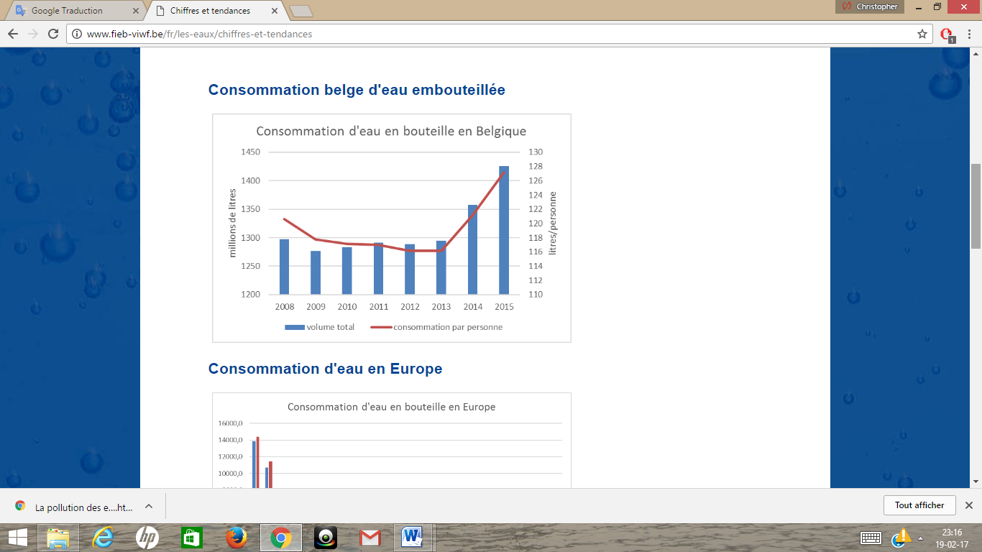
8. Do people drink bottled or tap water ?
In Belgium: 127 litres of bottled water per year per inhabitant >< 31,2 litres of tap water
In the classroom, four students drink bottled water and two drink the tap water.
In Portugal, we drink bottled water, yet, tap water is drinkable. In our school we dring tap water
Belgian consumption of bottled water :

Slide 11
9. What is the breakdown between traditional and organic farming?
17% of Sweden’s total area agricultural land. Almost everybody eats partly organic food.
Portugal: Most of people eat partly organic food due to the importance of agriculture in the country.
Turkey: The number of organic farmers has been rising.
Belgium: 5,13% of land is used to grow organic food.

Slide 12

10. Are there any quality labels recognised for sustainable food production?
In Belgium: Biogarantie
In Sweden: Krav
In Portugal: Agrobio
In Turkey: there’s no label for sustainable food production.

Slide 13
11. What is the average of food wasted in your country?
The average of wasted food in Sweden is about 477 kg per person at the year 2015.
In Portugal the average of wasted food is about 1 million tons per year.
The average of wasted food in Turkey couldn’t be found, but the most wasted food for their country is bread. Every day is about 5 million bread wasted.
In Belgium is the average of wasted food is 345 kg per person in one year.
In Europe the average of wasted food is 173kg per person in one year.

Slide 14
February 2017 - Food and farming meeting in Belgium
Quiz
What was one of the main goals agreed in 2015 during the COP21 in Paris that will apply from 2020 ?
A) To keep global temperatures "well below" 3.0 °C above pre-industrial times and "endeavour to limit" them even more, to 1.5°C.
B) To keep global temperatures "well below" 2.0 °C above pre-industrial times and "endeavour to limit" them even more, to 1.5°C.
C) To keep global temperatures "well below" 1.0 °C above pre-industrial times and "endeavour to limit" them even more, to 0.5°C.

Slide 15
February 2017 - Food and farming meeting in Belgium
Quiz
What is an Ecological Footprint?
A) The Ecological Footprint measures how fast we consume resources and generate waste compared to how fast nature can absorb our waste and generate new resources.
B) The Ecological Footprint measures how fast we generate waste compared to how fast nature can absorb our waste.
C) The Ecological Footprint measures how fast we consume resources and how fast nature can generate new resources.

Slide 16
February 2017 - Food and farming meeting in Belgium
Quiz
In Europe the average of wasted food is :
A) 173kg per person in one year.
B) 203kg per person in one year.
C) 223kg per person in one year.

Slide 17
February 2017 - Food and farming meeting in Belgium
Quiz
In Sweden, what is the breakdown between traditional and organic farming?
  A) 7% of Sweden’s total area agricultural land.
  B) 12% of Sweden’s total area agricultural land.
  C) 17% of Sweden’s total area agricultural land.

Slide 18
February 2017 - Food and farming meeting in Belgium
Quiz
In Europe the average of wasted food is :
A) 173kg per person in one year.
B) 203kg per person in one year.
C) 223kg per person in one year.

Slide 19

Thanks to all the students and teachers!

