Slide 1
Ecosystems
Portugal, Sweden, Turkey, Belgium

Slide 2
Group 1

Slide 3
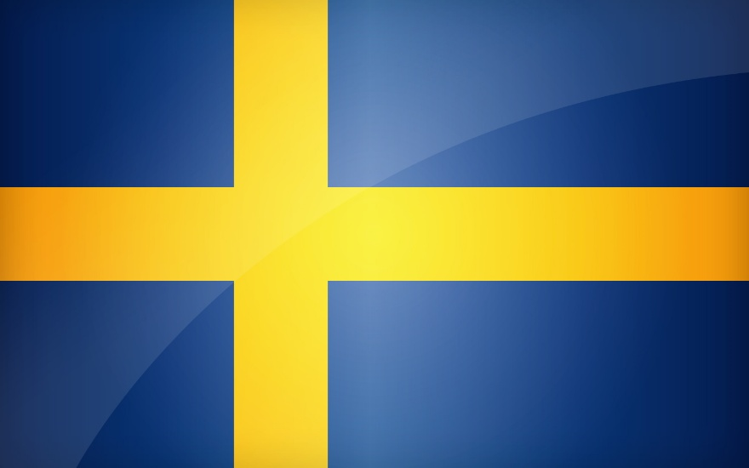

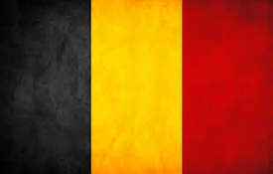

Ecosystems
Portugal, Sweden, Turkey, Belgium

Slide 4
Question 1
Portugal:
Fishing is a major economic activity in Portugal. The country has a long tradition in this sector, and is among the countries in the world with the highest fish consumption per capita.
One of the main aquaculture projects of Portugal is the Pescanova`s production centre. The southern portuguese region of the Algarve is also a major aquaculture centre.
-Sardine, chub mackerel, pacific mackerel, horse mackerel...
Sweden:
-Eel- the eel is classified as acute threatened to extinction, despite this the eel can be found in the waters of Gothenburg.
-Shore crab- this crab feeds on a variety of molluscs, worms and small crusteaceans, potentially impacting a number of fisheries.

Slide 5
Question 2
Sweden:
-Harring, salmon, cod and mackerel.
Portugal:
In Portugal, fishing, is an economic activity that is responsible for fishing 170053 tones in 2007.
The share of fishing and agriculture in national wealth has decreased in a few decades. These two sectors still employ 13% of the working population but generate only 4% of GDP.
The ocean has some of the world`s richest fishing resources, especially near the coastal areas .
Because of the threats to the ocean presented by oil spills, marine debris, and the incineration of toxic waste at sea, various international treaties exist to reduce some forms of pollution.

Slide 6
Question 3
Portugal:
At the dunes there is a negative vegetation, composed mainly of graminean and spruce plants that play an important role in the formation and fixation of the dunes. As the pioneer vegetation grows, the dunes gain volume and height.
Foredune: elytrigia juncea
Yellow dune: othanthus maritimus
Dune grassland: ceorema album
Woodland: Pinus pinaster. In the northern and mid part of the coastline several introduced acacia from australia play a local, but increasingly important role, in the development of dune scrub and woodland.
The pine or pinus pine is a coniferous tree specie of the family Pinaceae. Present in the Mediterranean basin, the tree, when mature, is recognized by its characteristic port as a deployed parasol.
Sweden:
The activity taught us the importance of maintaining the ecosystems of the dunes as our lifestyles are affecting a lot of species.

Slide 7
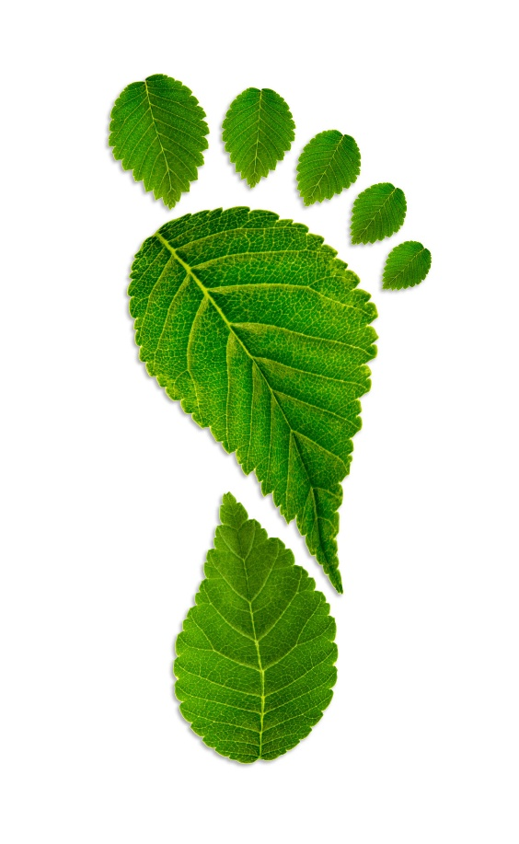
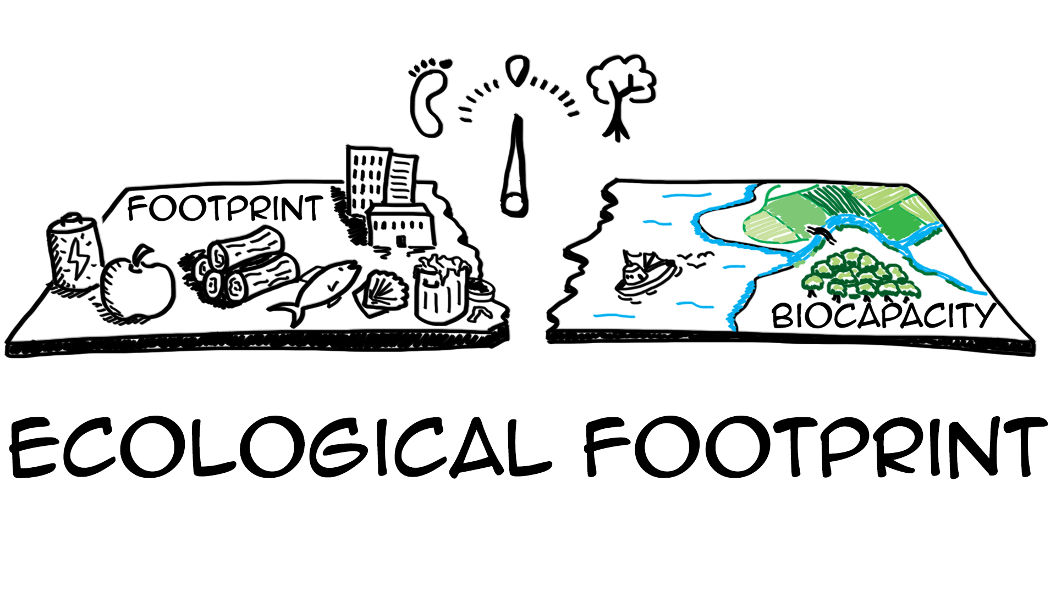
Ecological footprint
Belgium: 7
Sweden: 6
Turkey: 3,33
Portugal: 3,8

Slide 8
Beatriz Pereira / Francisca Loureiro / Eyup Gok / Arif Carpar / Marino Celeste / Duthoy Maxime / Clara Ulmestrand / Evelyn Nilsson

Slide 9
Group 2

Slide 10
Mediterranium Forest
By: Amanda Pereira / Rita Silva / Erik Berg / Adam Foureaux / Samet Sahin / Eyupcan Sen / Guebs Valentin / De moffarts Mathieu

Slide 11
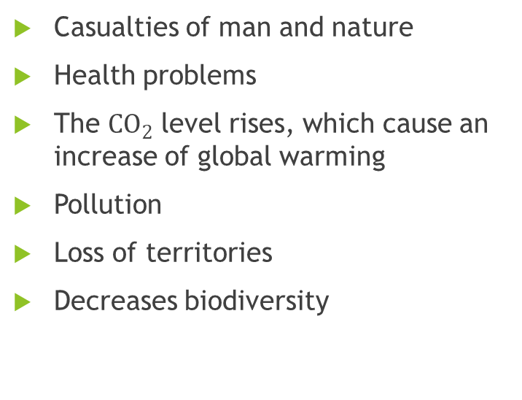
Question 4 – Aspects of forest fires
Positives
Negatives
Increase the fertility of the soil.
Some plants need fire to germinate
It decreases competition which allows some species to thrive.
Predators uses fire to flush out prey.
It drives the natural selection forward, thus contributing to evolution.
Casualties of man and nature
Health problems
The ${CO}_{2}$ level rises, which cause an increase of global warming
Pollution
Loss of territories
Decreases biodiversity

Slide 12
Question 5 – Economic importance of trees
These trees are important to economy because:
They can be used to produce medical drinks that can cure fevers and stop vomiting;
Early sailing ships used oak;
They are used in tanning and furniture industry.
Oak is good to store the wine in, it adds taste.

Slide 13
Question 6 – Portuguese coast erosion
Coast erosion is the effect of ocean waves slowly making the land disappear.
In Portugal coastal erosion’s causes are both natural and anthropogenic.
The main reasons are:
  Increase of the sea level
  Destruction of the natural landscapes
  Massive constructions made to prevent erosion
  Excessive human litoral occupation
The Vagueira litoral in Aveiro is the most affected place of coastal erosion in Portugal, however the public believe that Caparica, Lisboa is the most affected place.

Slide 14
Group 3

Slide 15
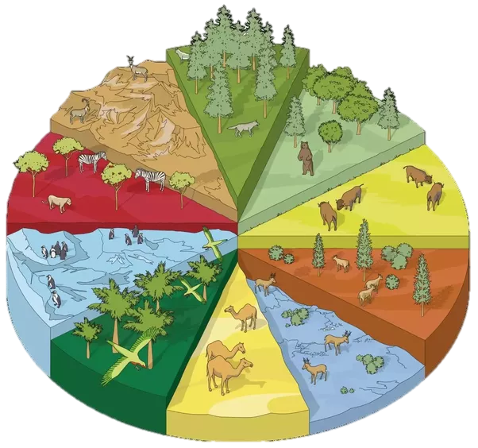
ECOSYSTEMS AND THEIR ISSUES
A project by group 3 by Erasmus+

Slide 16
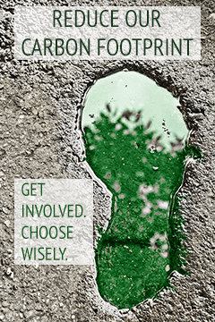
Citizen’s individual contribution to the climate changes:
Human activities have increased greenhouse gas concentrations in the atmosphere. Climatic warming or cooling arises from changes in the flows of energy through climate system that can have origin from a number of possible driving factors:
The Increase CO2 and other long-live greenhouse atmosphere in the atmosphere.
The use of aerossol

Slide 17
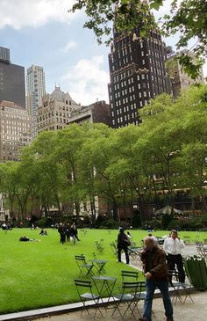
Public places where natural life is preserved should also be built. Places like the city parks, for example, which besides being beautiful places to relax and go for a walk also contribute to the preservation of natural life, namely trees.
This sort of concentrations of trees that should also be planted on the sides of our streets, for example, can improve the quality of the air we breathe.
Biodiversity has an important role in urban areas. It offers many advantages to humans, such as the sustenance and the function of ecosystems and many services, including climate regulation, ground formation and retention, resistance to invasive species, pollination of plants and control of pests and pollution.

Slide 18
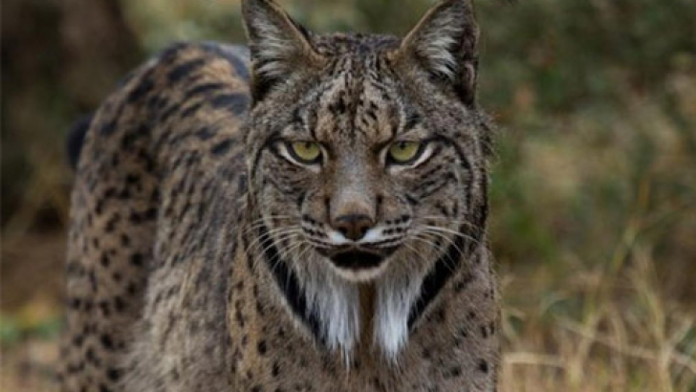

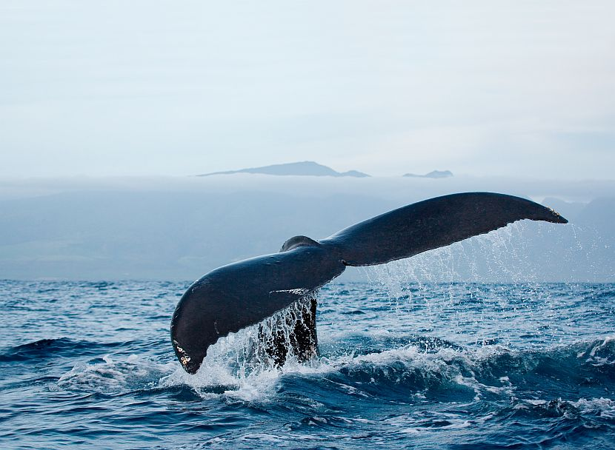
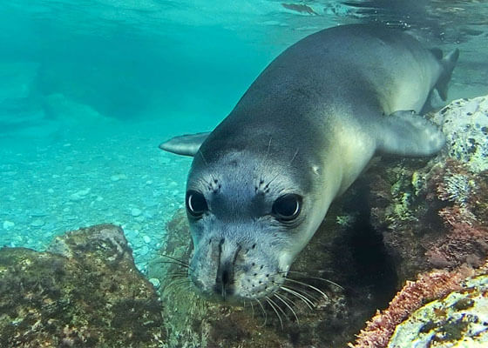
Endangered species in Portugal:
Iberian Lynx
Fin whale
Mediterranean monk seal

Slide 19
Ex-situ conservation and the Iberian Lynx:
In the wild, conservation measures need to be implemented effectively and efficiently, integrating efforts and working tools. Iberian lynx conservation could be conceived as a puzzle whose pieces should fit together adequately.
The lynx’s are depending on wild rabbits, and therefore, if humans are hunting the rabbits; the lynx’s will decrease. Since the rabbits are the primary food for the lynx’s, we need to increase the population of rabbits in the first place. This in in the progress by building fields, and building special fences etc. for the rabbits, that the lynx’s can take advantage of in time.

Slide 20
Programme’s contribution:
The non-extinction
They are most under the same selection pressures as wild species
Possible problems:
They are not in their natural habitat
They are forced to reproduce

Slide 21
Ana Simões / Gabriela Pinheiro / Maniscalco Hadrien / Ambroise Floymont / Malin Andersson / Therese Hällgren / Enes Coskun / Muarren Gumus

Slide 22
Multiple choices
Which is the major economic activity in Portugal?
Agriculture
Fishing
Raising Cattle

Slide 23
Multiple choices
Spot the wrong sentence
The economic importance of trees is wood commerce
The economic importance of trees is wine production
The economic importance of trees is to coal production

Slide 24
Multiple choices
What contributes to the greenhouse effect?
The increase CO2 in the villages
The use of aerosol
The rise of the global temperature

Slide 25
Multiple choices
What measures can we take to improve the quality of life in cities?
Create public places where natural life is preserved
Use pesticides
Preserve biodiversity in urban areas

Slide 26
Multiple choices
Identify an endangered specie:
Iberian lynx
Glass frog
Brazilian spider

