Slide 1

COP21 and the new climate deal of 2020

Slide 2
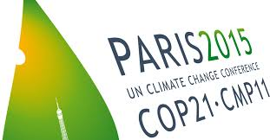

The purpose and outcome of COP21

Slide 3

What is the general opinion in your country about environmental work in general and work for the climate specifically?

Slide 4

Turkey

Slide 5

Portugal

Slide 6

Belgium

Slide 7

Sweden

Slide 8

The Eurpean cooperation concerning these types of deals

Slide 9
MULTIPLE CHOISE QUESTIONS
1.When was UN Conference on Climate Change in Paris?
2013
2014
2015
2. What is the general opinion in Belgium about environmental work in general and work for the climate specifically?
They are very interested in environmental questions
They are not interested in environmental questions
The population in age between 40-60 years old are interested

Slide 10
Climate change and sustainable energy
Erasmus

Slide 11
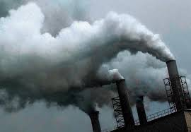
How serious is the climate change of today?
Today
The global temperature has risen by 0.74 degrees celcius since 1906.
Melting arctic ice
Natural catastrophies.
Health concerns
Running out of resources
Acidification

Slide 12
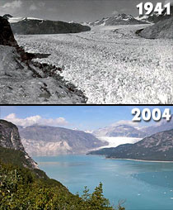
In the future
Can rise up to 3.4 degrees celcius by the end of the century.
Higher sea levels
More severe and frequent catastrophies.
Health concerns
Out of resources
More consequenses that we might not know of today
Extinction of species

Slide 13
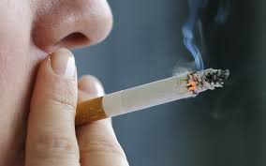
In what ways do humans contribute to climate change?
Carbon dioxides emissions
Meat industry emitts methane gas
Fertilisation medicine effects species
Use of non renewable sources, such as fossil fuels in transportation devices, industries etc.

Slide 14
Measures to reduce climate change
New transportation methods
New energy sources
Less meat consumption, more vegetarian options
Filters in factories to prevent emissions
Global recycling

Slide 15

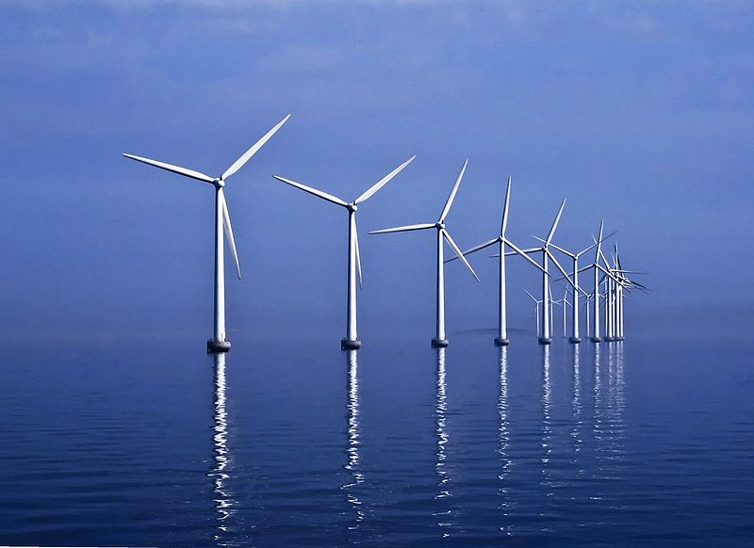
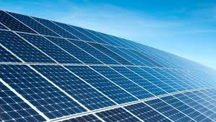
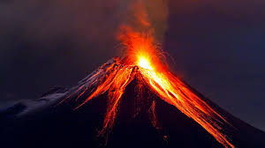
Current measures in our countries
Sweden:
Windmills and hydroelectric powerplants
Recycling
Portugal:
Wave energy
Heat from volcanos
Belgium:
Recycling
Biomethanisation
Turkey:
Solar power plants

Slide 16
Multiple choise Questions
1. How many degrees Celsius has the global temperature risen since 1906?
0,24 °C
0,54 °C
0,74 °C
2. To reduce the emission of greenhouse gases Portugal has developed
Hydroelectric power plants
Solar power plants
Wave energy power plants

Slide 17

Which energy sources are mainly used for energy production in your country? Name 3.

Slide 18

Which energy sources are mainly used for energy production in your country? Name 3.

Slide 19

Which energy sources are mainly used for energy production in your country? Name 3.

Slide 20

Which energy sources are mainly used for energy production in your country? Name 3. Shortly, describe the mechanisms of energy production from these sources.
1
2
3

Slide 21

What are the environmental impacts of the three most common energy sources in your country, specifically on the climate?

Slide 22
What are the environmental impacts of the three most common energy sources in your country, specifically on the climate?

Slide 23
What are the environmental impacts of the three most common energy sources in your country, specifically on the climate?

Slide 24
What are the environmental impacts of the three most common energy sources in your country, specifically on the climate?

Slide 25
Which renewable energy sources are your country investing in? How does the future look like within this area?

Slide 26
Which renewable energy sources are your country investing in? How does the future look like within this area?
1
2

Slide 27
Which renewable energy sources are your country investing in? How does the future look like within this area?

Slide 28
Which renewable energy sources are your country investing in? How does the future look like within this area?

Slide 29
Portugal
Energy sources:
Oil and natural gas
RPortugalenewable energy as Wind and waves
Impacts on the environment:
- Melting ices, rising sea level
Co2
More extreme weather conditions.
Acid rain
Thinner ozon layer in the sky due to CFC
Renewable sources investing in, such as:
Geothermal
Eolic
Hidroeletric
Solar
Biomass

Slide 30
Turkey
Energy sources:
Gas
Wind
Coal
Impacts on the environment:
Carbondioxide emission
Harm ecosystems
Investing in renewable energy sources, such as:
Hydropower
Methone
Wind power

Slide 31
Belgium
Energy sources:
Nuclear
Natural gas-
Oil
Impacts on the environment
- Melting ices, rising sea level
Co2
More extreme weather conditions.
Investing in energy sources such as:
Windpower
solarpower

Slide 32
Sweden
Energy sources:
Hydroelectric power
Nuclear power- thermal power
Wind power
Impacts on the environment:
Waterpower generates almost no emission but the constructions changes the ecosystem
Bioproducts from nuclearpower is dangerous to the environment and need to be taken care of
Energy sources investing in, such as:
Wind turbines without blades
Improve renewable energy sources

Slide 33
The end
Portugal: Gabriela, Beatriz
Turkey: Nisa, Samet
Belgium: Celeste, Maxime
Sweden: Sofia, Therese, Adam and Carolina

Slide 34
MULTIPLE CHOICE QUESTIONS
1. Which energy sources are mainly used for energy production in Sweden?
Hydroelectric power plants, Nuclear power- thermal power and Wind power
Solar power plants, Nuclear power- thermal power and Wave energy power plants
Wave energy power plants, Hydroelectric power plants and Solar power plants
2. Which energy sources are mainly used for energy production in Turkey?
Wave energi power plant, cole and solar power plants
Natural gas, wind power plants and cole
Wave energy power plants, hydroelectric power plants and cole

